Slide 1




Home Credit Default Risk (HCDR)
I526 Applied Machine Learning
FP_GroupN_HCDR_5 - Phase 4
Naveen Rao Vardhineni Alexis Perez Bharath Veldi Anurag Nampally

Slide 2

INTRODUCTION
The course project is based on Home Credit Default Risk (HCDR) Kaggle competition.
The goal is to predict whether or not a customer can be flagged as a high risk applicant.
Final Phase will involve intensive experimentation and building deep learning models using PyTorch, a multi-headed load default system using the OOP API with combined loss function: CXE + MSE

Slide 3
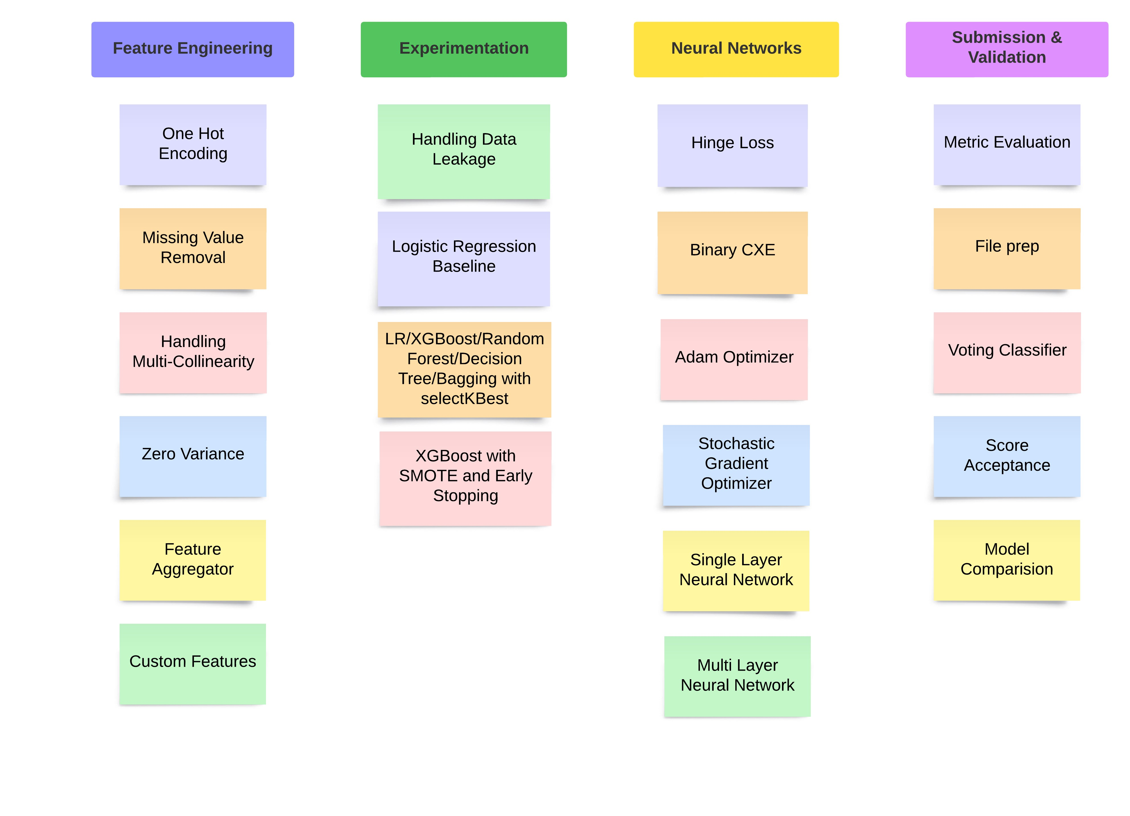
PROGRESS

Slide 4
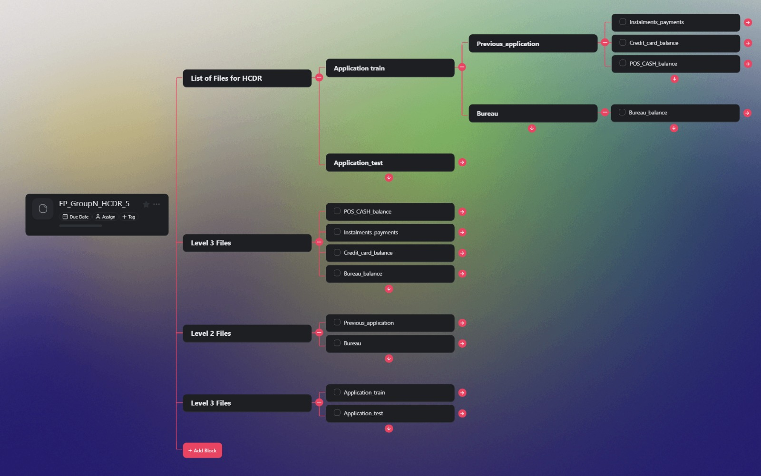
Feature Engineering

Slide 5
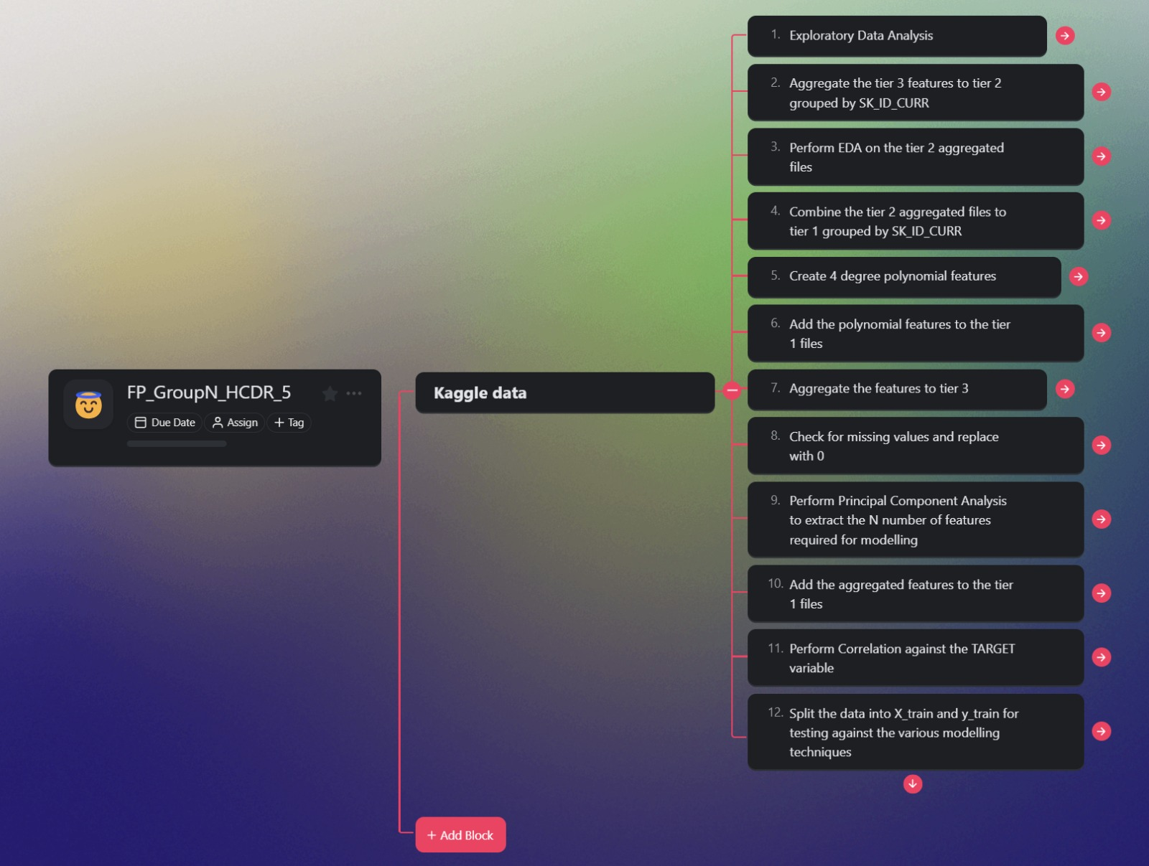
Feature Engineering

Slide 6
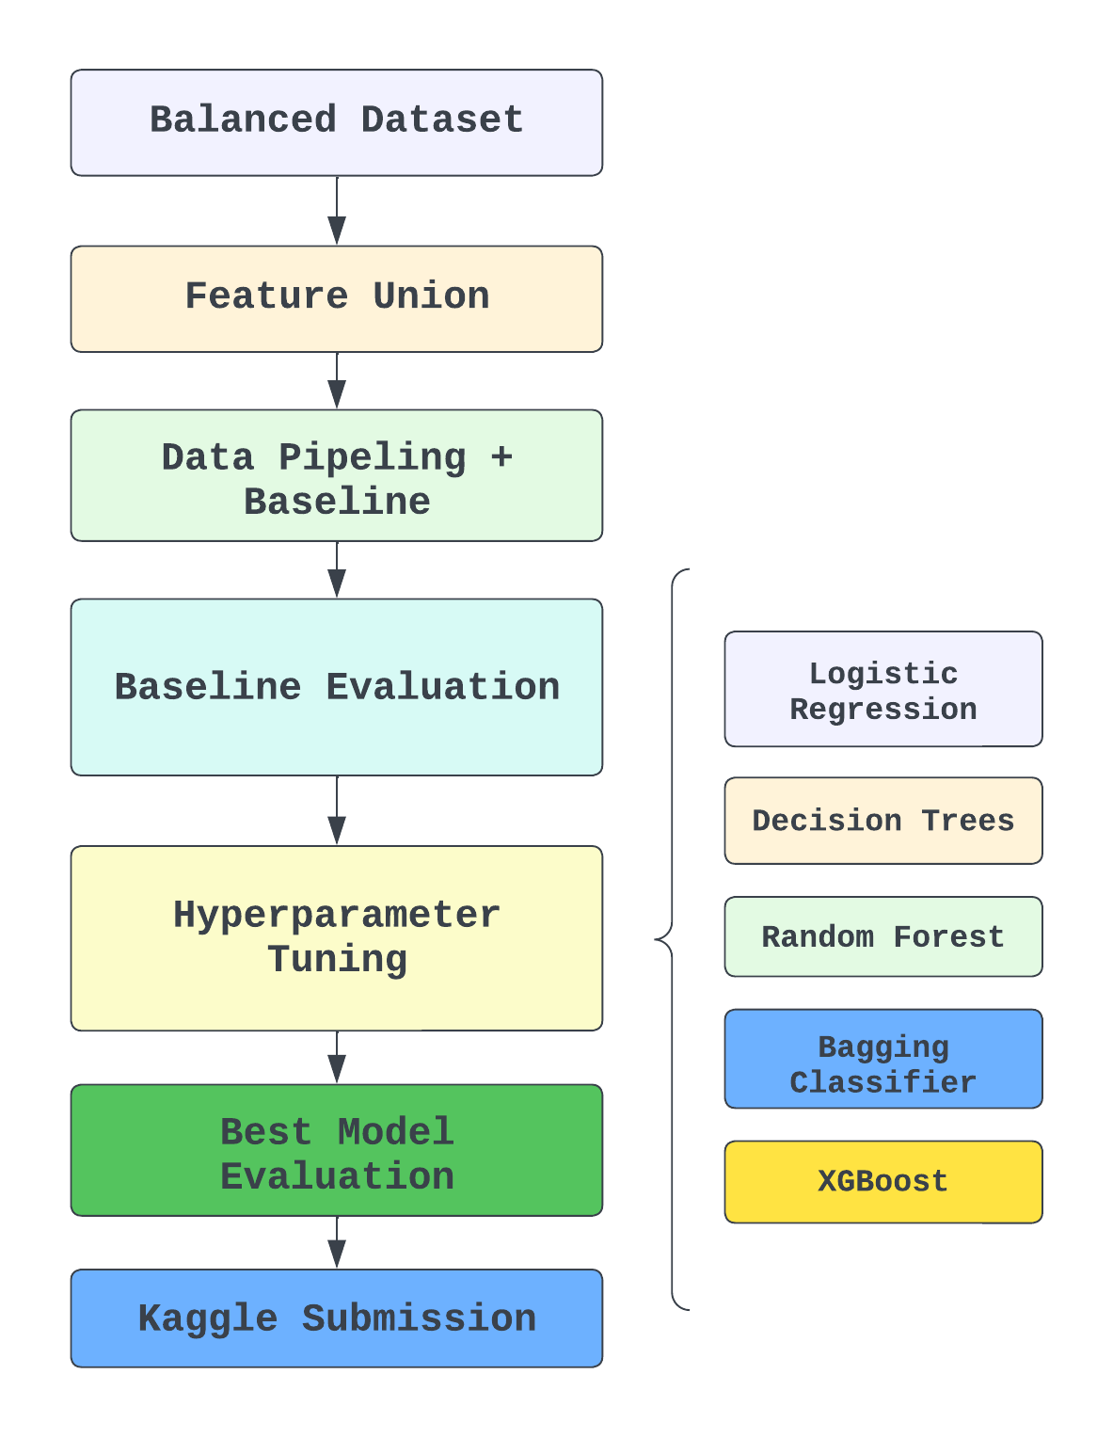
Previous Model Pipeline

Slide 7
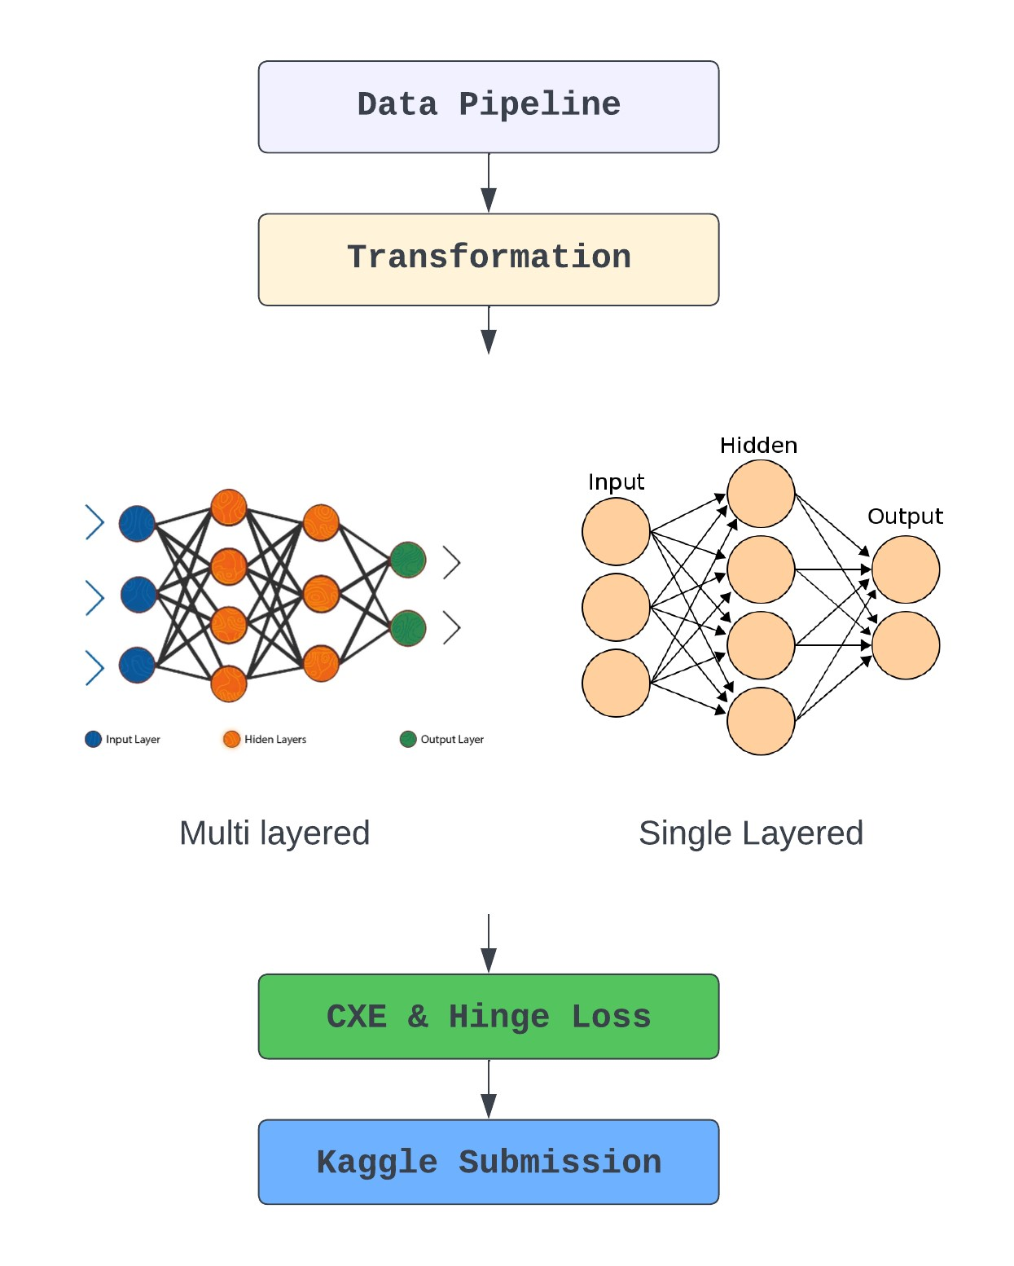
Deep learning Model Pipeline

Slide 8
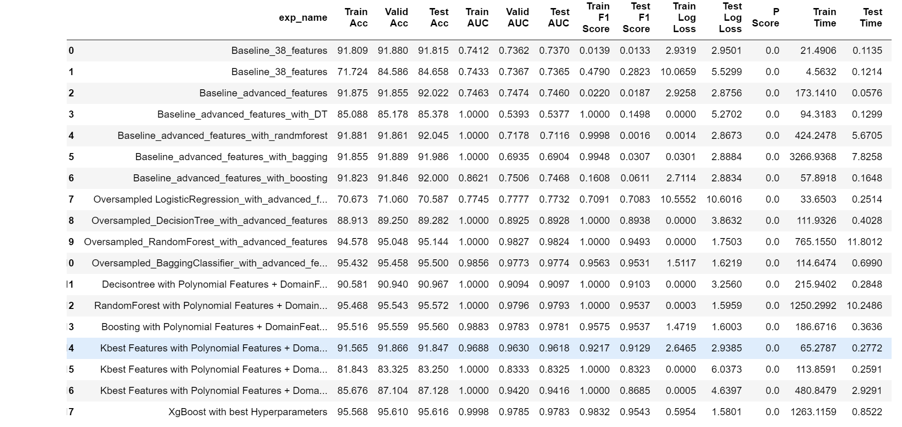
Experiment Results (Traditional Models)

Slide 9
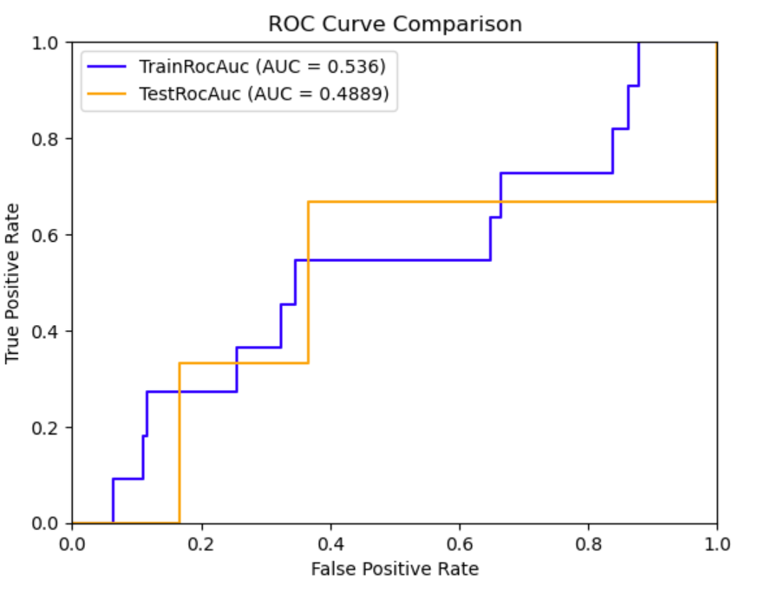
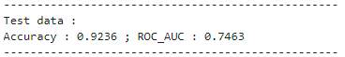
Experiment Results (Neural Network)
Single layer results
Multi layer results

Slide 10
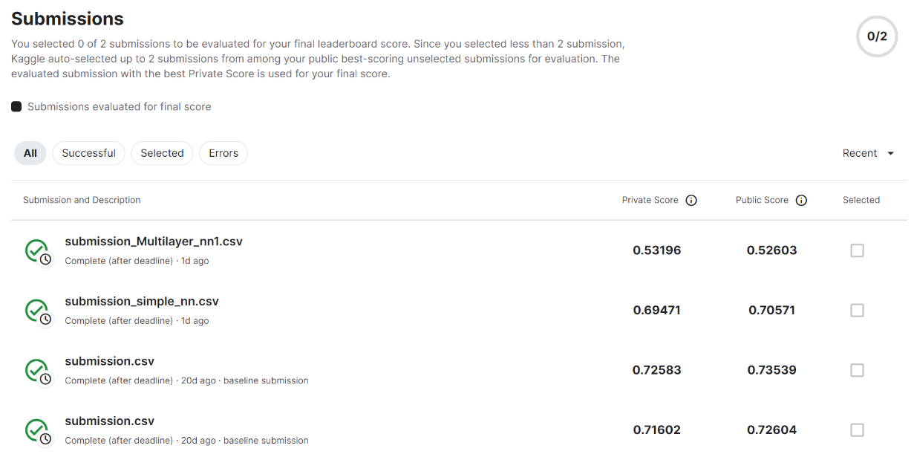
Kaggle submission

Slide 11
Conclusion
The XGBClassifier model, tuned for optimal performance, excels across multiple evaluation metrics, including precision, recall, F1 score, accuracy, and ROC AUC score. Its ability to effectively predict both positive and negative cases, coupled with low rates of false positives and false negatives, attests to its reliability and suitability for the HCDR classification task. Overall, the results provide confidence in the model's capability to make accurate predictions and its potential for practical deployment in real-world scenarios.

Slide 12
Future Scope
Conduct a more in-depth EDA to understand the characteristics of the data.
Explore additional feature engineering techniques to create new informative features.
Optimize hyperparameters.
Improving Neural nets and choosing optimum loss functions.

Slide 13
Thank You…

